Slide 1


NLP-2: Classical Representations & Probabilistic Models
SOUMYADEV SAHA

Slide 2
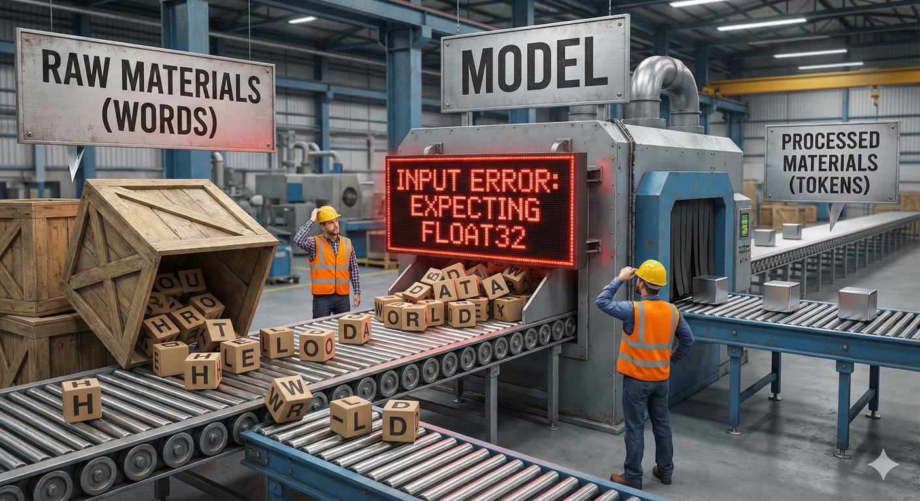
SRIB
PAGE 02
Where we left off: The Cleaned Corpus
Input: Raw messy text ("HTML", "Slang", "Emojis").
Process: Regex -> Tokenization -> Stop Words -> Stemming/Lemmatization.
Output: The Vocabulary(V). A list of unique, standardized tokens.
The Problem: We have a list of words. But Machine Learning models cannot take "text" as input. They only accept Vectors (Numbers).

Slide 3
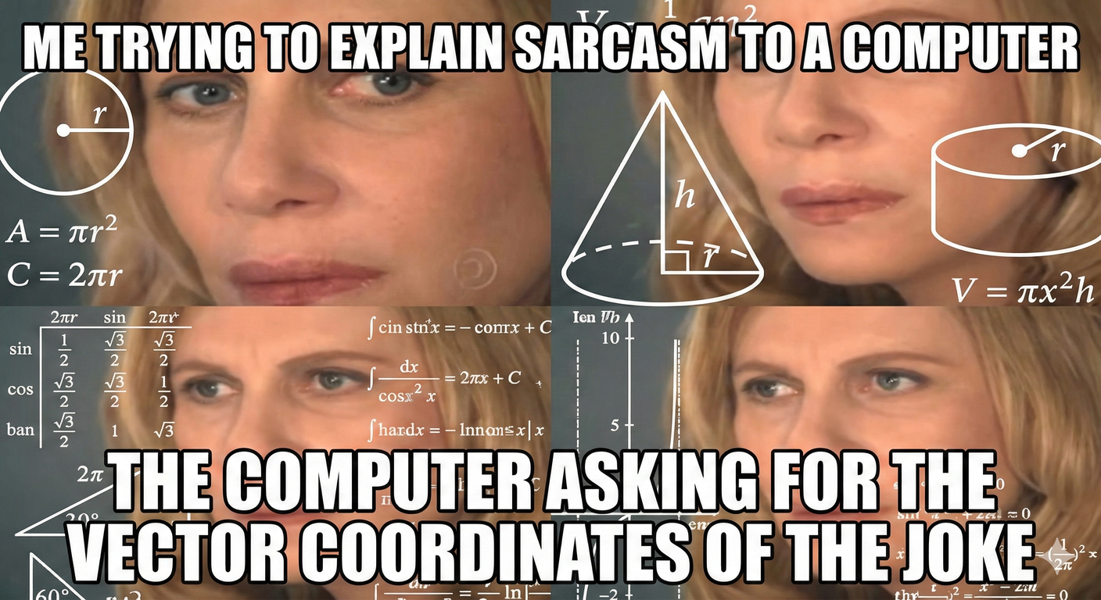
SRIB
PAGE 03
Computers can't read. They can only count.
You understand the word "Apple". You visualize a red fruit, a tech company, maybe a pie.
To a computer, "Apple" is just a string of bytes 01000001. It has no semantic meaning.
The Goal of Day 2: Feature Extraction. We need to convert these words into Vectors (Lists of numbers) so we can do math on them.

Slide 4
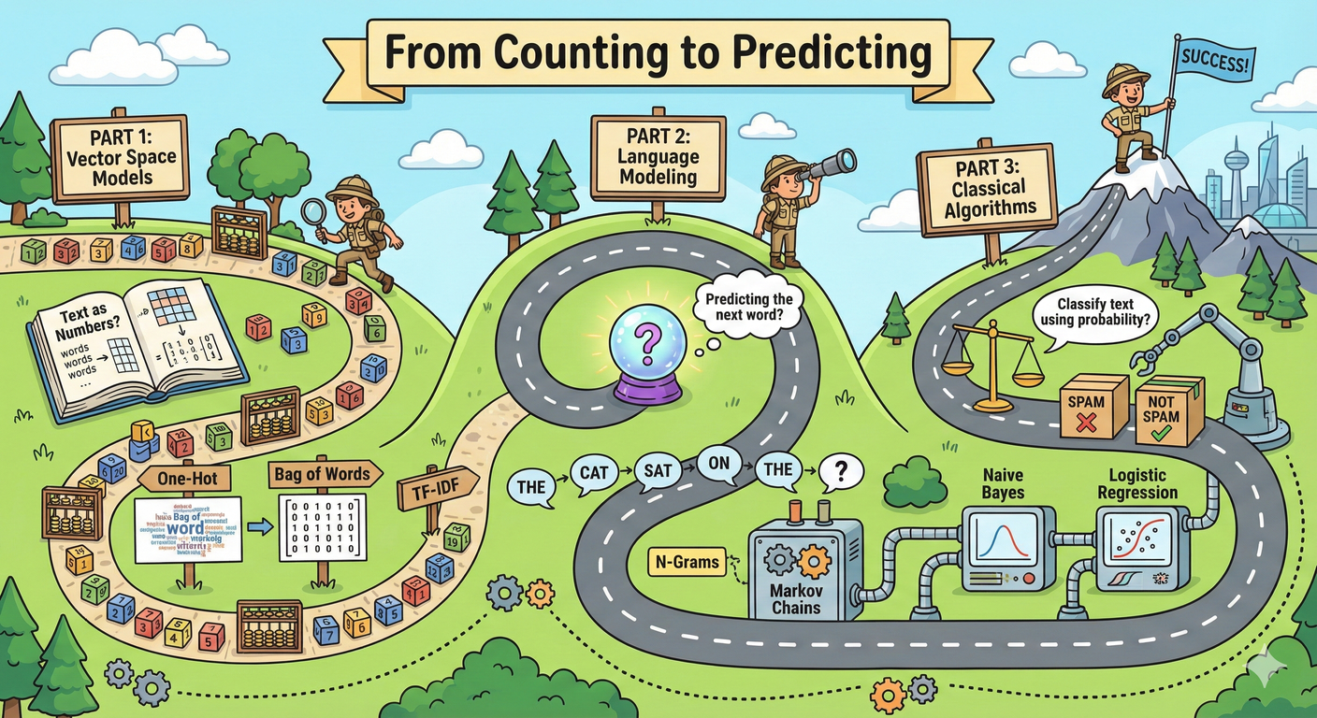
SRIB
PAGE 04
Today's Roadmap: From Counting to Predicting
Part 1: Vector Space Models. (One-Hot, Bag of Words, TF-IDF). How do we represent text as numbers?
Part 2: Language Modeling. (N-Grams, Markov Chains). How do we predict the next word?
Part 3: Classical Algorithms. (Naive Bayes, Logistic Regression). How do we classify text using probability?

Slide 5

SRIB
PAGE 05
The Simplest Representation: One-Hot Encoding
Logic: Assign every word in the Vocabulary a unique index i.
Vector: A vector of length |V| (size of vocab) where position i is 1, and all others are 0.
Example:
Vocab: [Apple, Banana, Cat]
"Apple" --> [1, 0, 0]
"Cat" --> [0, 0, 1]

Slide 6
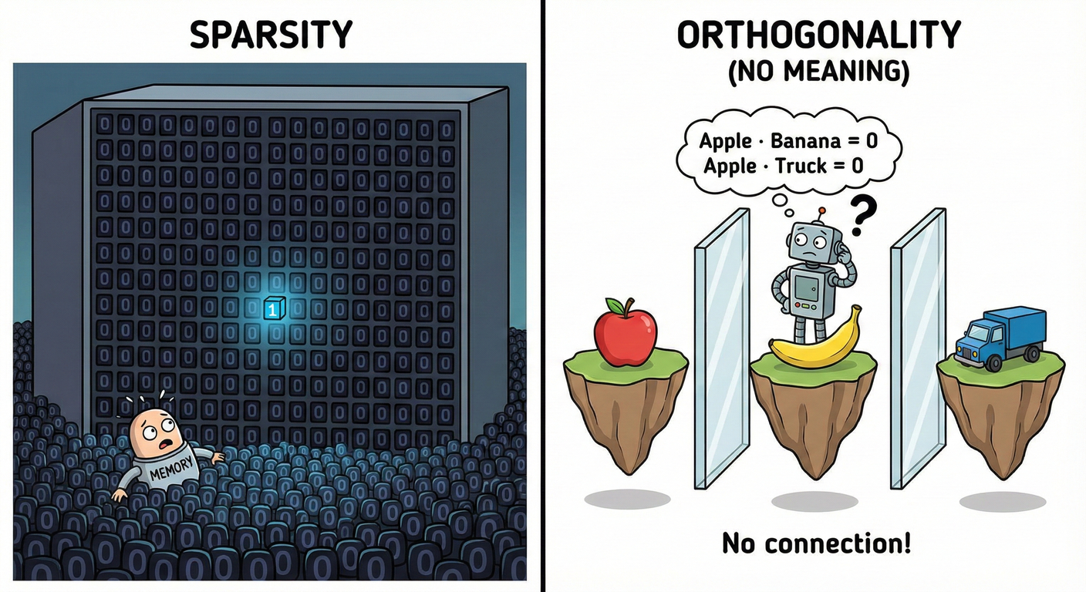
SRIB
PAGE 06
Why One-Hot Fails in Production
Sparsity: English has ~170,000 words. Your vector size is 170,000. It contains a single '1' and 169,999 '0's. This is a massive waste of memory.
Orthogonality (No Meaning):
Dot Product: Apple . Banana = 0.
Dot Product: Apple . Truck = 0.
The model thinks "Apple" is just as different from "Banana" as it is from "Truck". Semantic relationships are lost.

Slide 7
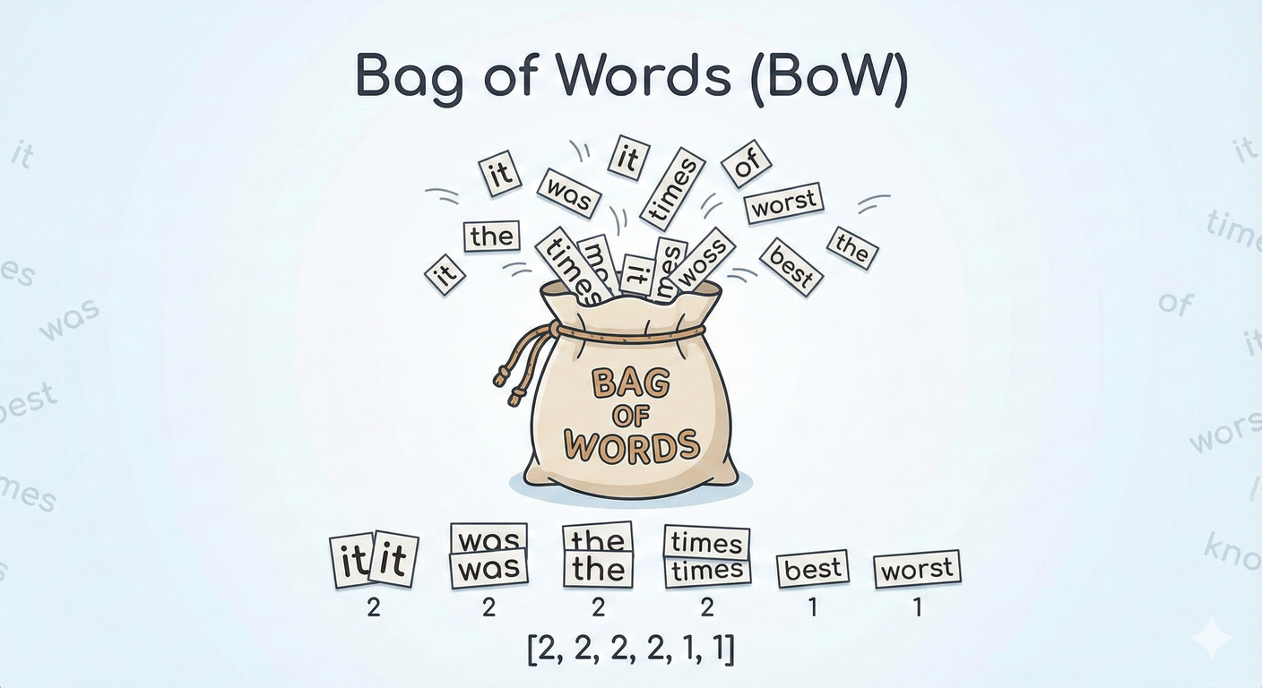
SRIB
PAGE 07
Bag of Words (BoW): Counting Frequency
The Shift: Instead of focusing on position, we focus on frequency.
Analogy: Take a sentence, cut out every word, throw them into a bag, and shake it. We lose the order, but we keep the content.
Example:
Doc 1: "It was the best of times, it was the worst of times."
"it": 2, "was": 2, "the": 2, "times": 2, "best": 1, "worst": 1.
Vector: [2, 2, 2, 2, 1, 1]

Slide 8
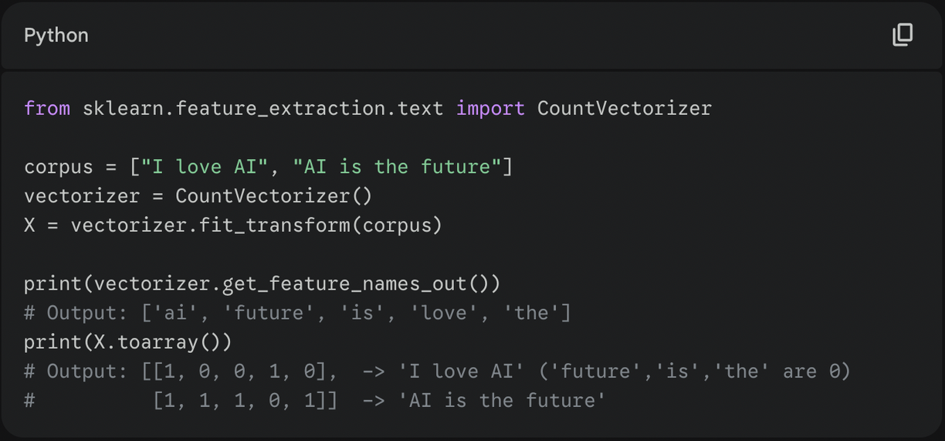

SRIB
PAGE 08
Hands-on: BoW in Scikit-Learn
Observe how CountVectorizer automatically tokenizes and lowercases by default.

Slide 9
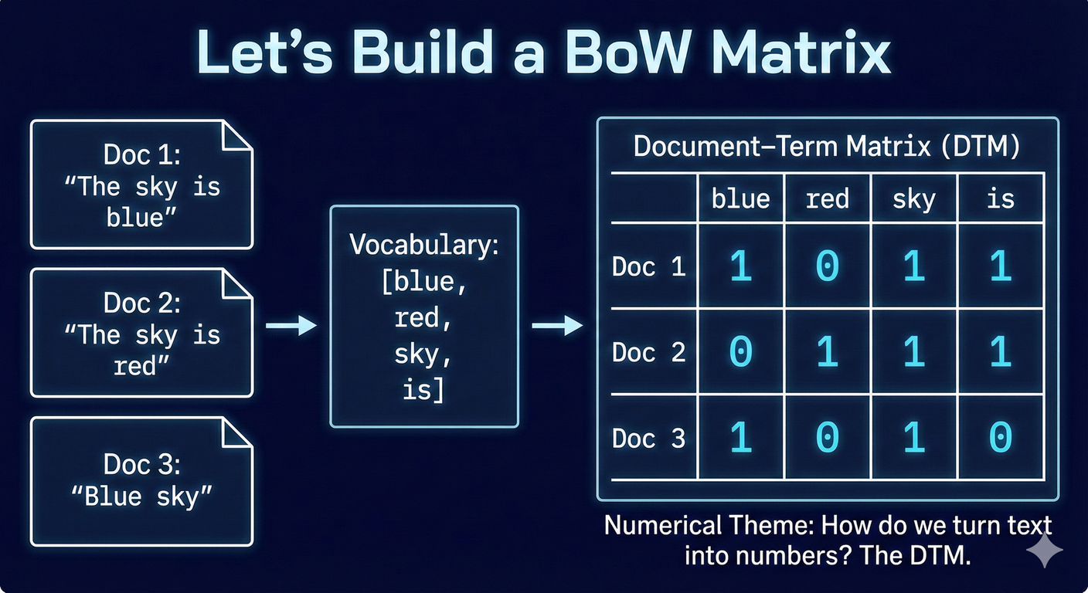
SRIB
PAGE 09
BoW Numerical Example
Vocab: [blue, red, sky, is]
Doc 1: "The sky is blue" -> [1, 0, 1, 1] (Stop word "the" removed? Let's assume kept for now).
Doc 2: "The sky is red" -> [0, 1, 1, 1]
Doc 3: "Blue sky" -> [1, 0, 1, 0]
This matrix is called the Document-Term Matrix (DTM).

Slide 10
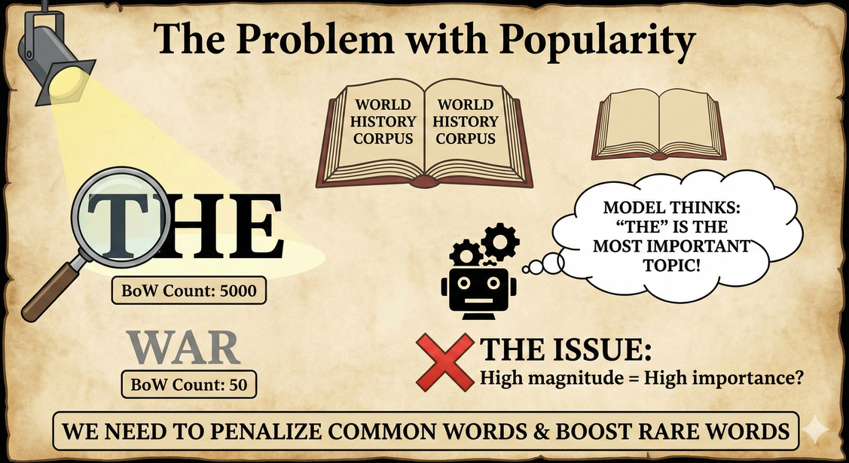
SRIB
PAGE 10
Issue with Raw Counts: The "Common Word" Problem
In a large corpus, words like "good", "data", or "thing" might appear thousands of times.
Does high frequency always mean high importance?
Example: In a document about "Quantum Physics", the word "the" appears 500 times. The word "Quantum" appears 10 times.
BoW thinks "the" is 50x more important than "Quantum". This is wrong.
We need a way to punish common words and reward rare, specific words.

Slide 11
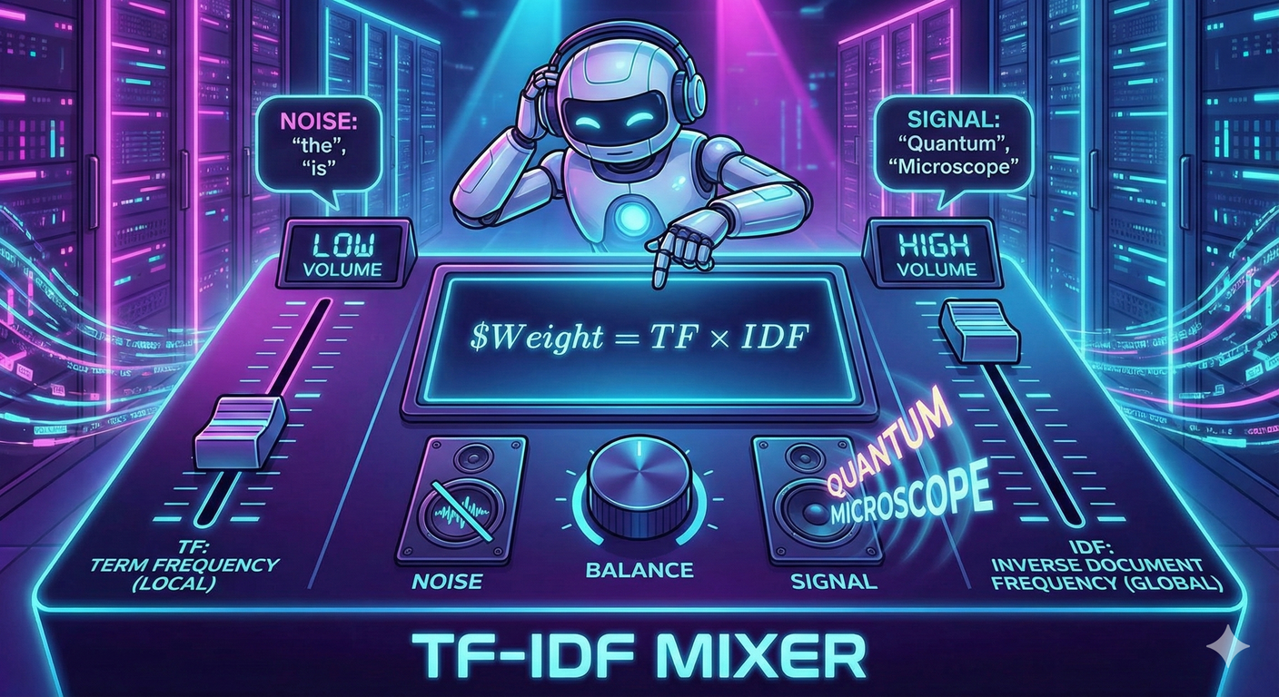
SRIB
PAGE 11
Enter TF-IDF : Term Frequency - Inverse Document Frequency
The Philosophy: A word is important if:
It appears frequently in this document (TF).
It appears rarely in other documents (IDF).
Analogy: If everyone owns a Ferrari (Common), it's not special. If only you own a Ferrari (Rare), it defines you.
Formula: Weight = TF X IDF
This is the "DJ Mixer" of NLP. It turns down the volume on noise ("the", "is") and turns up the volume on signals ("Quantum", "Microscope").

Slide 12
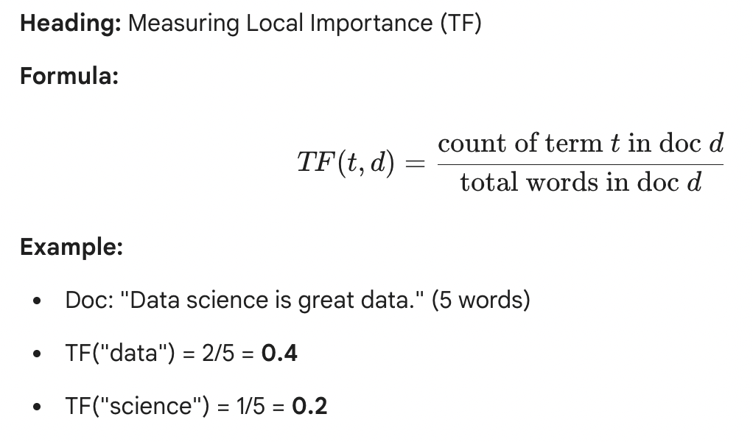
SRIB
PAGE 12
Part 1: Measuring Local Importance (TF)

Slide 13
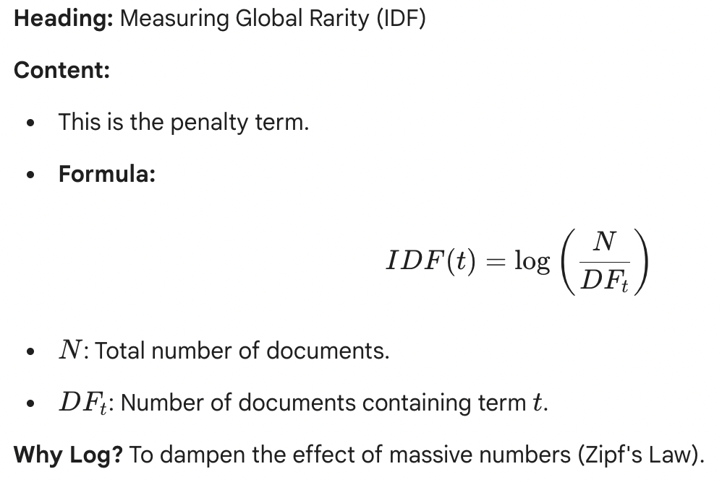
SRIB
PAGE 13
Part 2: Measuring Global Rarity (IDF)

Slide 14
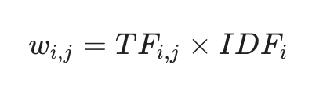
SRIB
PAGE 14
Putting it Together (TF * IDF)
Example Calculation:
Doc A: "The AI" (Total corpus: 10 docs. "The" in 10, "AI" in 1).
Word "The": TF (0.5) * IDF (0) = 0
Word "AI": TF (0.5) * IDF (1) = 0.5
Result: The vector represents the meaning (AI), not just the count.

Slide 15
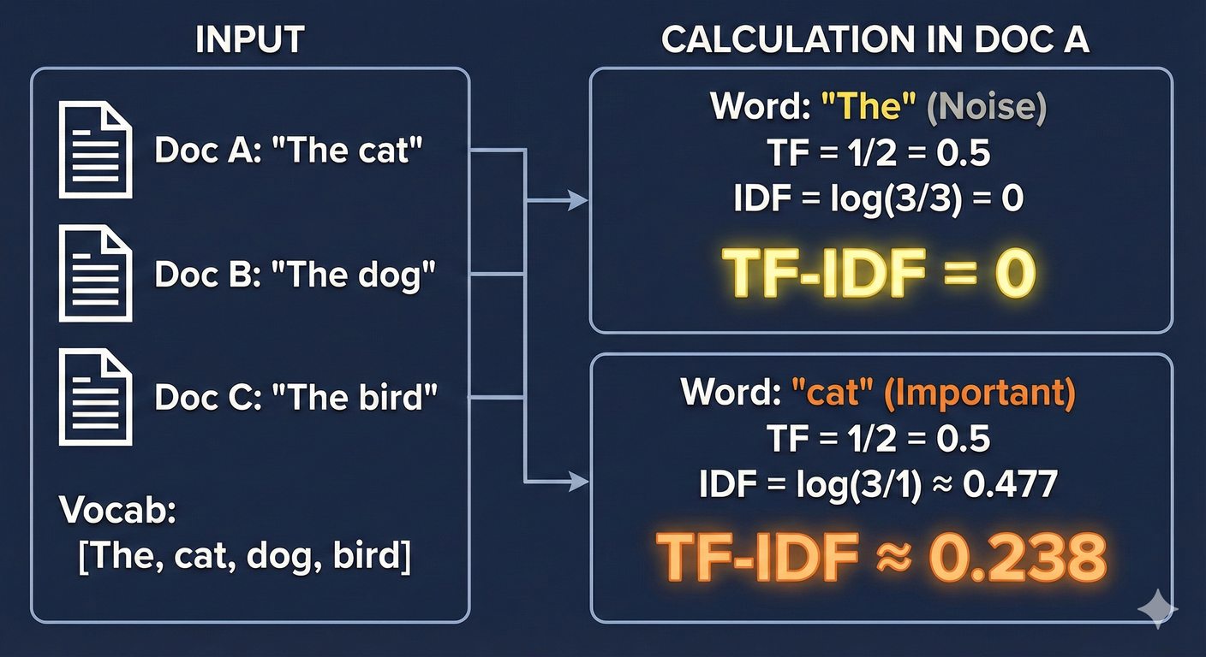
SRIB
PAGE 15
TF-IDF: A Numerical Example (Hands-on)
Doc A: "The cat", Doc B: "The dog", Doc C: "The bird"
Vocab: [The, cat, dog, bird]
Calculate "The" in Doc A:
TF = 1/2 = 0.5
IDF = log(3/3) = 0
TF-IDF = 0.5 * 0 = 0 (Correctly identified as noise).
Calculate "cat" in Doc A:
TF = 1/2 = 0.5
IDF = log(3/1) = 0.477
TF-IDF = 0.5 * 0.477 = 0.238 (This word defines the document).

Slide 16
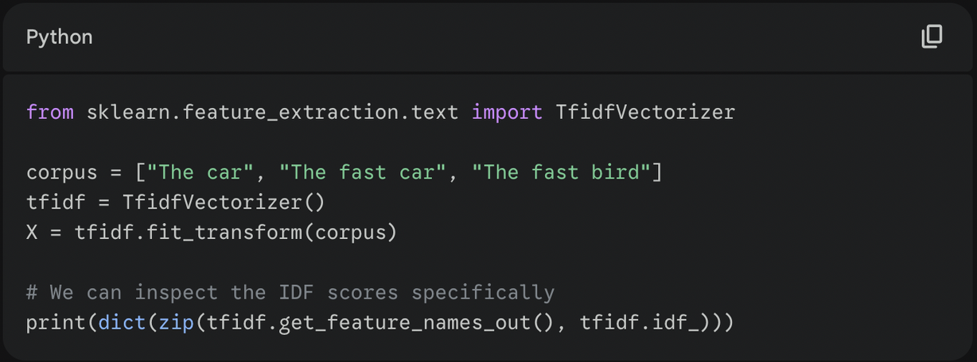
SRIB
PAGE 16
Hands-on: Codeing TF-IDF in Python
"Which word in the code above will have the lowest IDF score?" -> Answer: "The" (because it appears everywhere).

Slide 17
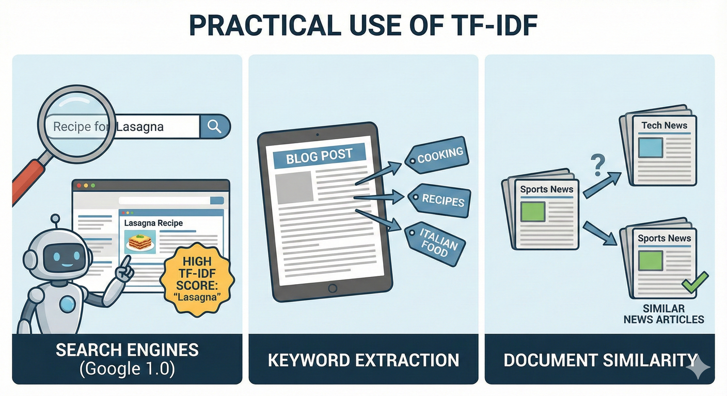
SRIB
PAGE 17
Where is TF-IDF used?
Search Engines (Google 1.0): When you search "Recipe for Lasagna", Google looks for pages where "Lasagna" has a high TF-IDF score (High frequency in the page, rare on the internet generally).
Keyword Extraction: Finding the tags for a blog post automatically.
Document Similarity: Finding similar news articles.

Slide 18
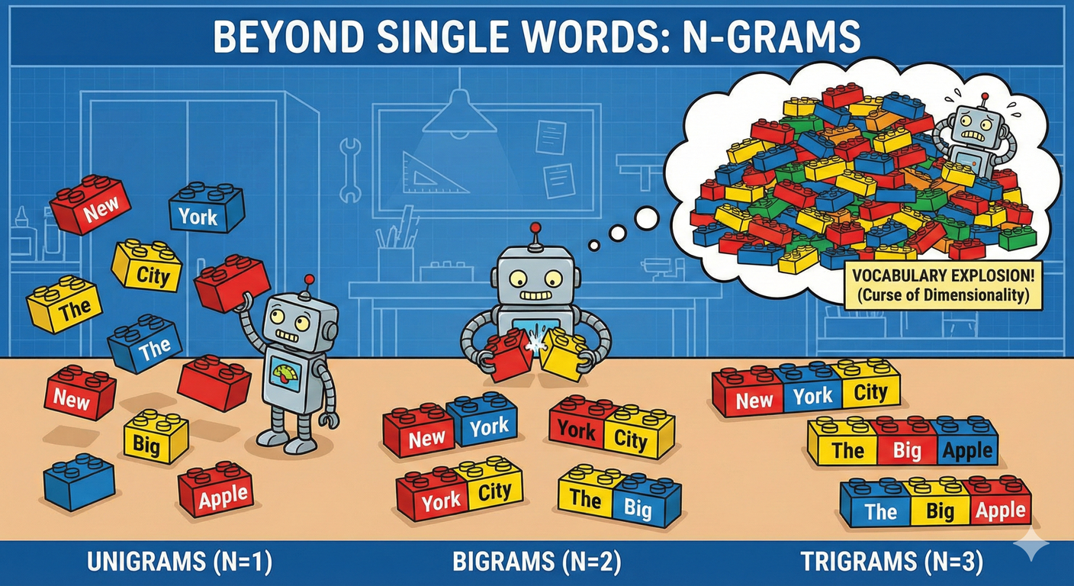
SRIB
PAGE 18
Beyond Single Words: N-Grams (preserving local order)
BoW and TF-IDF usually look at Unigrams (1 word).
Problem: "New York" is distinct from "New" and "York".
Bigrams (N=2): ["New York", "York City"]
Trigrams (N=3): ["New York City"]
Trade-off: As N increases, the Vocabulary size explodes exponentially (Curse of Dimensionality).

Slide 19
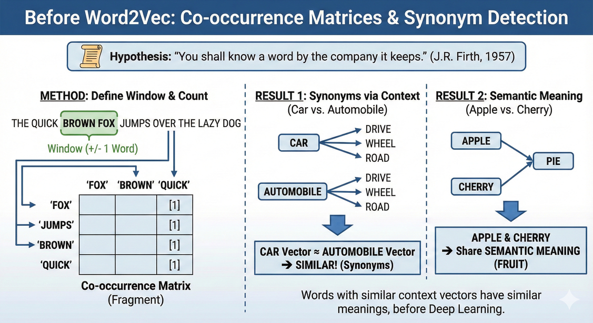
SRIB
PAGE 19
Context Window & Co-Occurrence
Before Word2Vec (Deep Learning), we used Co-occurrence matrices to find synonyms.
Hypothesis: "You shall know a word by the company it keeps." (J.R. Firth, 1957).
Method:
Define a window (e.g., +/- 1 word).
Count how often Word A appears next to Word B.
Result: "Car" and "Automobile" will both have high co-occurrence with "Drive", "Wheel", "Road". Their vectors will be similar!
Another Example: If "Apple" and "Pie" appear together often, and "Cherry" and "Pie" appear together often -> "Apple" and "Cherry" likely share semantic meaning (Fruit).

Slide 20
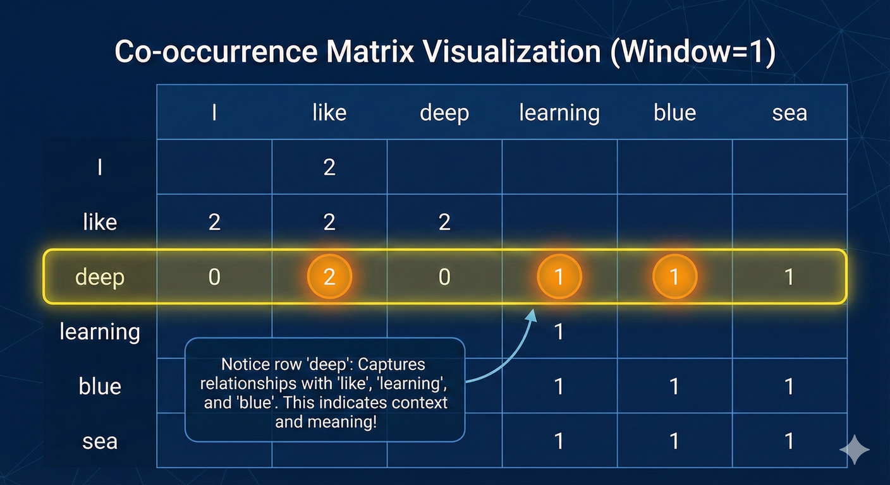
SRIB
PAGE 20
Co-Occurrence Visualization (The Matrix Layout)
Corpus: "I like deep learning. I like deep blue sea.", Window: 1
Notice row "deep": It has relationships with "like", "learning", and "blue". This captures meaning!

Slide 21
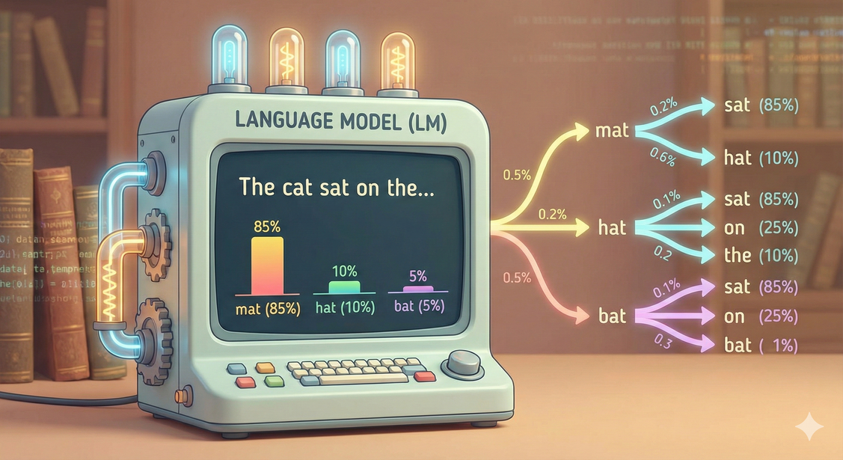
SRIB
PAGE 21
What is a Language Model (LM)?
An LM assigns a probability to a sequence of words.
Goal: Compute P(w_1, w_2, w_3, ... w_n)
Example 1:
P("I like ice cream") = High
P("I like ice socks") = Low
Use Cases: Autocomplete, Speech Recognition, Spelling Correction.
Example 2: "I want to eat a hot ____".
Human Brain: "Dog"? (50%), "Pepper"? (10%), "Car"? (0.001%).
An LM tries to replicate this statistical intuition.

Slide 22
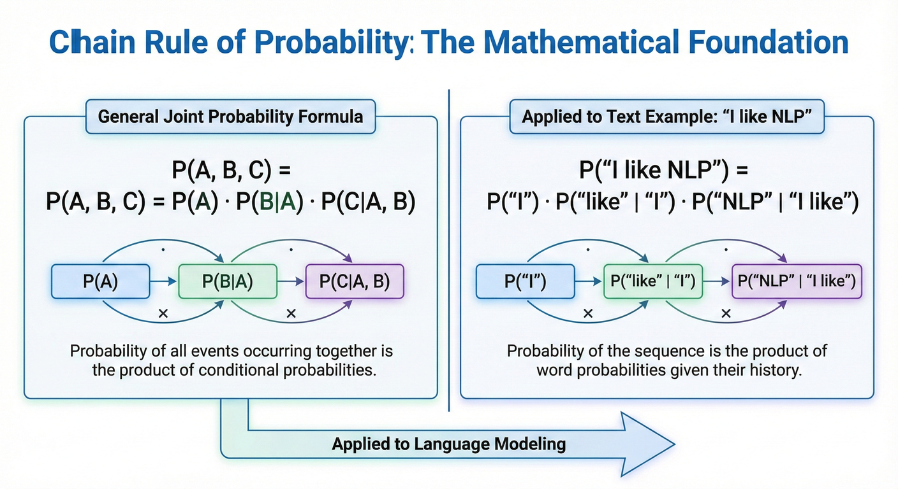
SRIB
PAGE 22
Chain Rule of Probability: The Mathematical Foundation
How to calculate joint probability:
P(A, B, C) = P(A) * P(B|A) * P(C|A, B)
Applied to Text:
P(“I like NLP”) = P(“I”) * P(“like” | “I”) * P(“NLP” | “I like”)

Slide 23
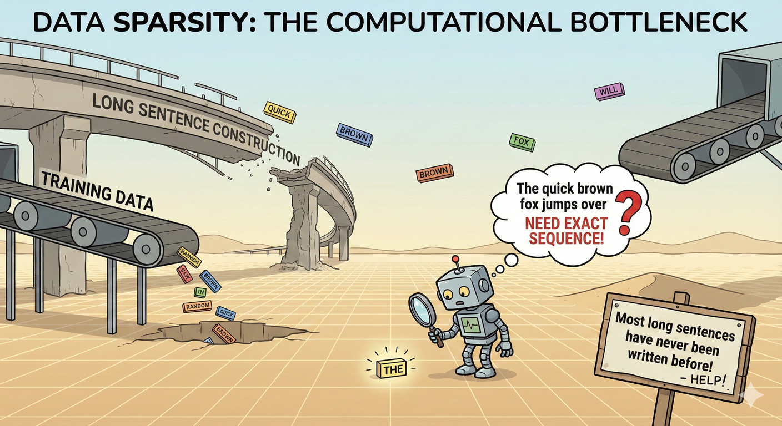
SRIB
PAGE 23
Why the Chain Rule is Impossible
To calculate P(word_10 | word_1...word_9), we need to have seen that exact sequence of 9 words many times in our training data.
Data Sparsity: Most long sentences have never been written before in human history.
We need an approximation.

Slide 24
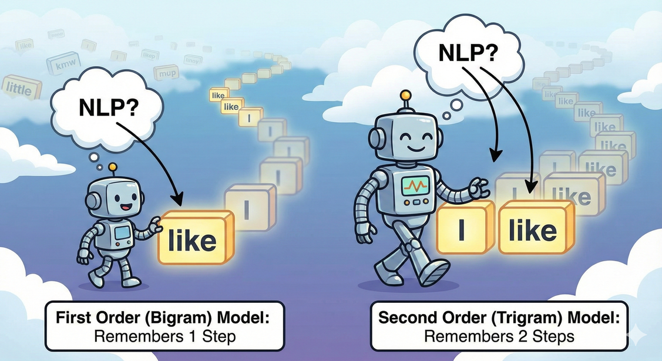
SRIB
PAGE 24
The Markov Assumption
Assumption: The probability of the next word depends only on the last k words. History doesn't matter beyond that.
First Order (Bigram Model): Look back 1 word.
P(“NLP” | “I like”) ≈ P(“NLP | ”like”)
Second Order (Trigram Model): Look back 2 words.

Slide 25
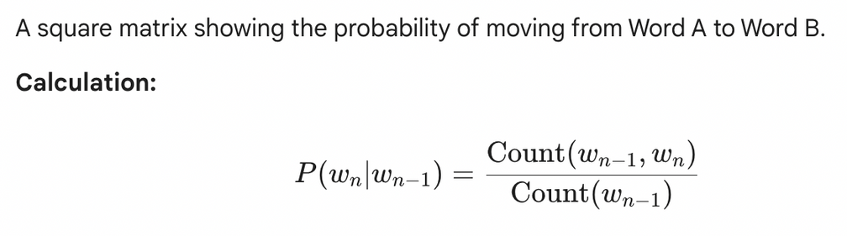
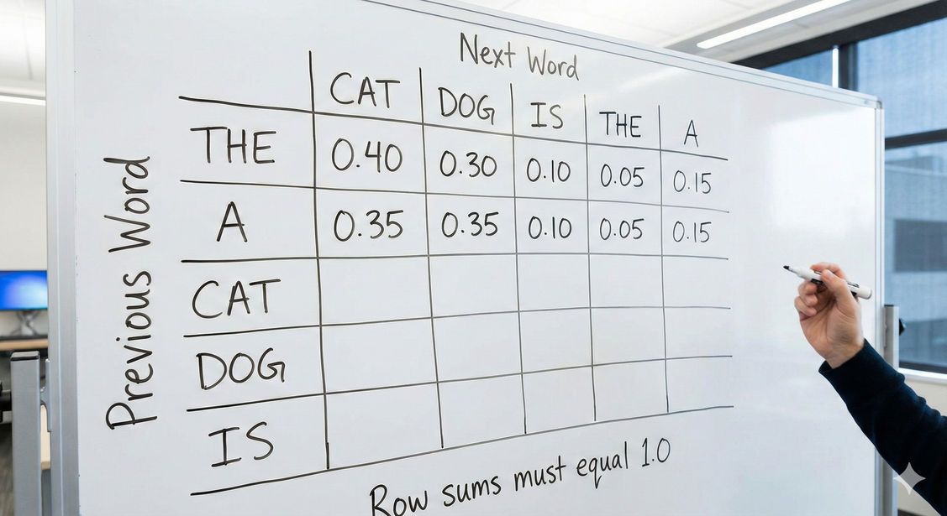
SRIB
PAGE 25
Building a Transition Matrix

Slide 26
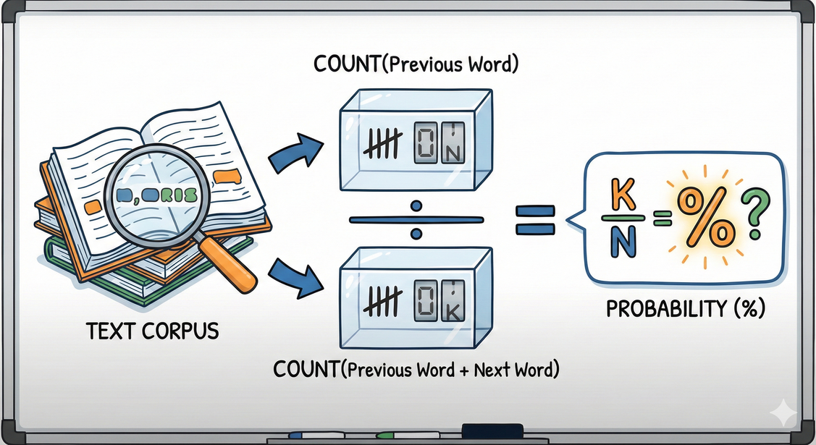
SRIB
PAGE 26
Hands-on: Numerical - Let's Calculate Probabilities
Corpus: "Sam I am I am Sam"
Task: Calculate P(“Sam” | “am”)
Step 1: Count("am") = 2.
Step 2: Count("am Sam") = 1. (The instance at the end).
Result: 1 / 2 = 0.5.
If the model sees "am", there is a 50% chance the next word is "Sam".

Slide 27
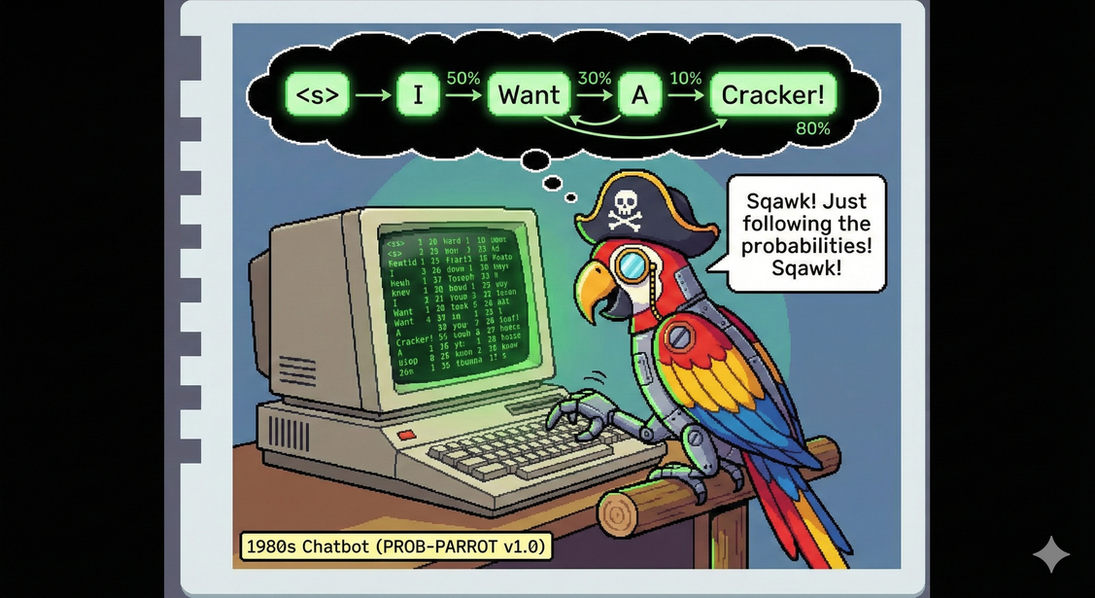
SRIB
PAGE 27
Language Generation (The Fun Part)
Once we have the matrix, we can "Generate" text.
Start with token <s> (Start of sentence).
Look at row <s>. "I" has highest probability. Pick "I".
Look at row "I". "Want" has highest probability. Pick "Want".
Look at row "Want"...
Historical Fact: This is how early "Chatbots" worked in the 1980s. They were just probabilistic parrots!

Slide 28
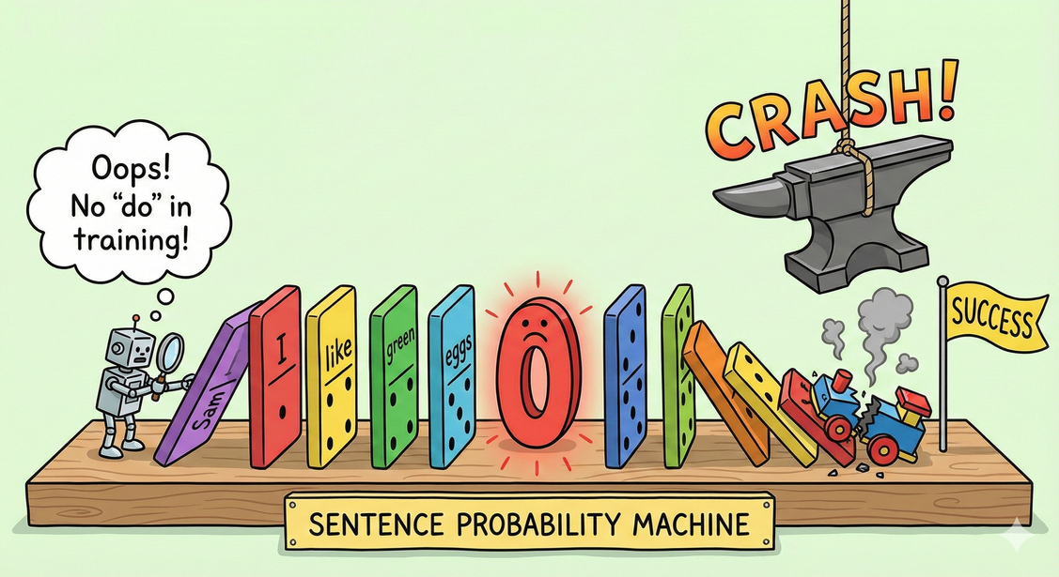
SRIB
PAGE 28
The Zero Probability Trap
Scenario: Test set has phrase "Sam I do".
Training data never had "I do". Count = 0.
Probability = 0.
Consequence: Since we multiply probabilities, a single zero turns the entire sentence probability to Zero.
The model crashes.

Slide 29
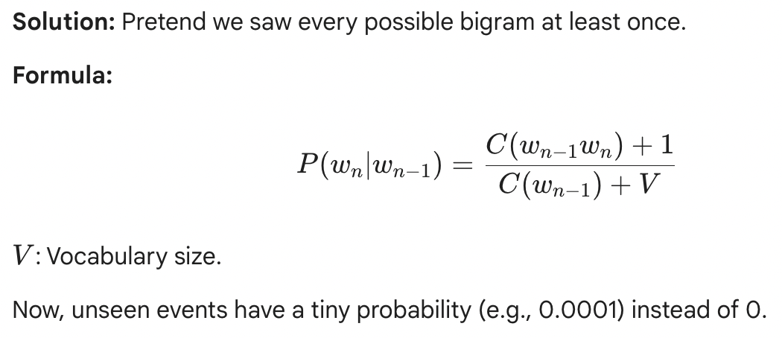
SRIB
PAGE 29
Laplace Smoothing (Add-One)

Slide 30

SRIB
PAGE 30
Knowledge Checkpoint 1
Q1: Which model treats "The dog bit the man" and "The man bit the dog" as exactly the same?
Ans: Bag of Words (BoW).
Q2: In a Bigram model, the next word depends on how many previous words?
Ans: One.
Q3: Why do we add +1 in Laplace Smoothing?
Ans: To avoid zero probabilities crashing the model.

Slide 31
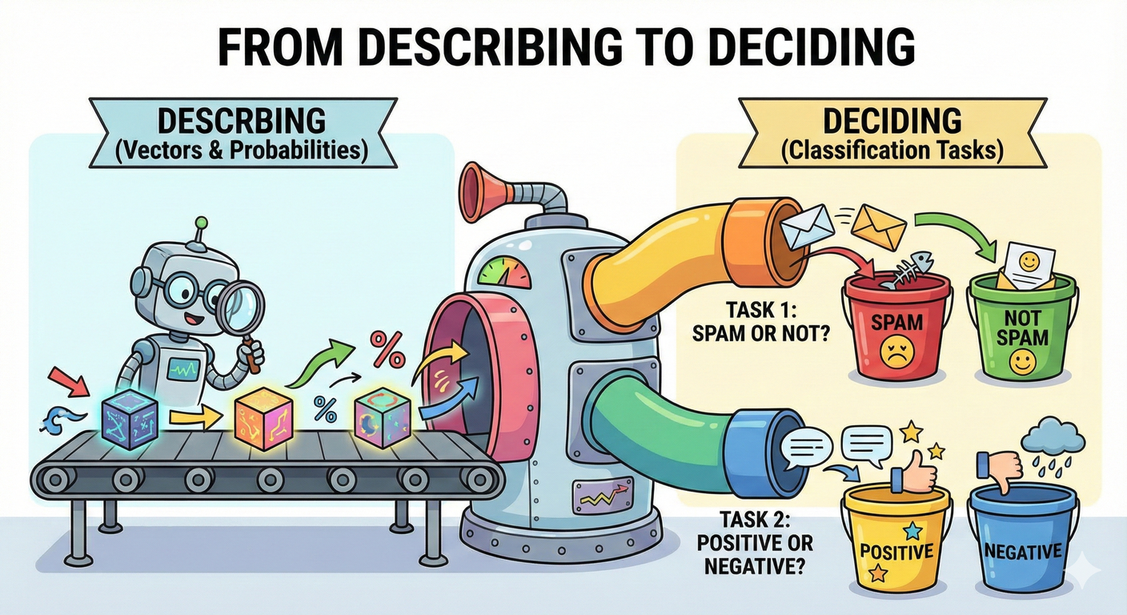
SRIB
PAGE 31
Intro to Text Classification: From Describing to Deciding
We have Vectors. We have Probabilities. Now let's classify.
Tasks:
Spam Detection (Spam vs. Ham)
Sentiment Analysis (Positive vs. Negative)
Topic Classification (Sports vs. Politics)

Slide 32
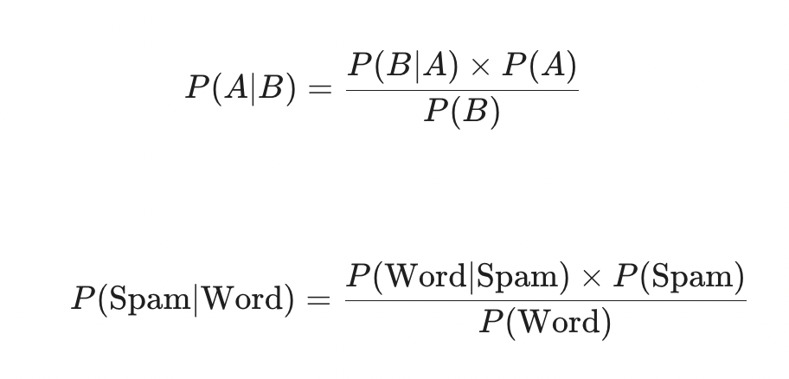
SRIB
PAGE 32
The Magic Formula (Bayes' Theorem)

Slide 33
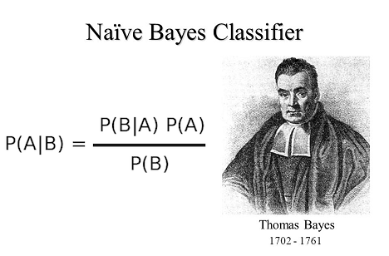
SRIB
PAGE 33
Why is Naive Bayes called “Naive” ?
We assume that words are conditionally independent. (The “Naive” assumption) i.e., it assumes every word is independent of every other word.
It assumes "Bank" in "River Bank" has nothing to do with "River" or, assume "San" does not predict "Francisco". We treat them as separate clues.
Why? It simplifies computation drastically.
Surprise: Despite being "wrong", it works incredibly well for text classification.

Slide 34
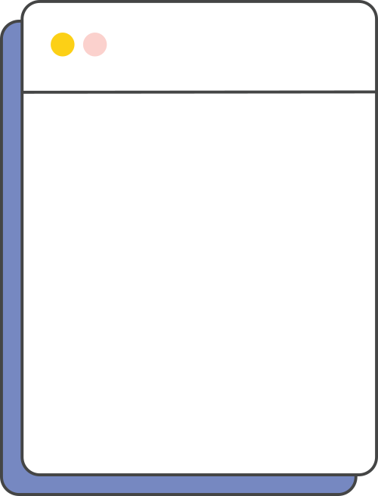
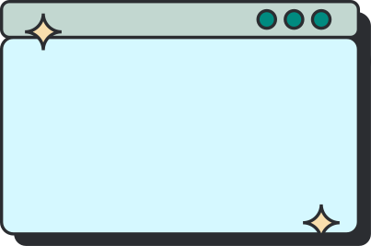
SRIB
PAGE 34
Naive Bayes Numerical Walkthrough
Training Data:
Spam (3 docs): "Buy cheap meds", "Cheap money", "Buy now".
Ham (2 docs): "Meeting now", "Cheap meeting".
P(Spam) = 3/5. P(Ham) = 2/5.
Task: Classify new email "Cheap meds".
Spam Calculation:
P(“Cheap”|”Spam”) = 2/3 (appearances/total spam docs).
P(“Meds”|”Spam”) = 1/3.
Score = 0.6 (Prior) * 0.66 * 0.33 = 0.13.
Ham Calculation:
P(“Cheap”|”Ham”) = 1/2.
P(“Meds”|”Ham”) = 0/2 -> Apply Smoothing! -> let's say 0.01.
Score = 0.4 * 0.5 * 0.01 = 0.002.
Comparison: 0.13 > 0.002. Prediction: Spam.

Slide 35
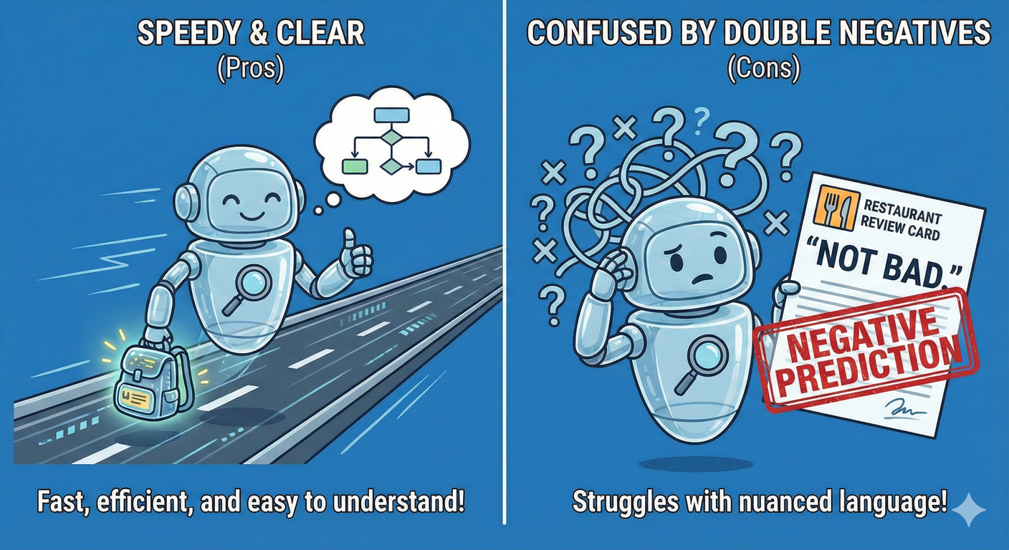
SRIB
PAGE 35
Pros and Cons of Naive Bayes
Pros: Fast, needs little training data, interpretable.
Cons: Fails on "Double Negatives" (e.g., "Not bad" -> Naive Bayes sees "Bad" and predicts Negative).

Slide 36
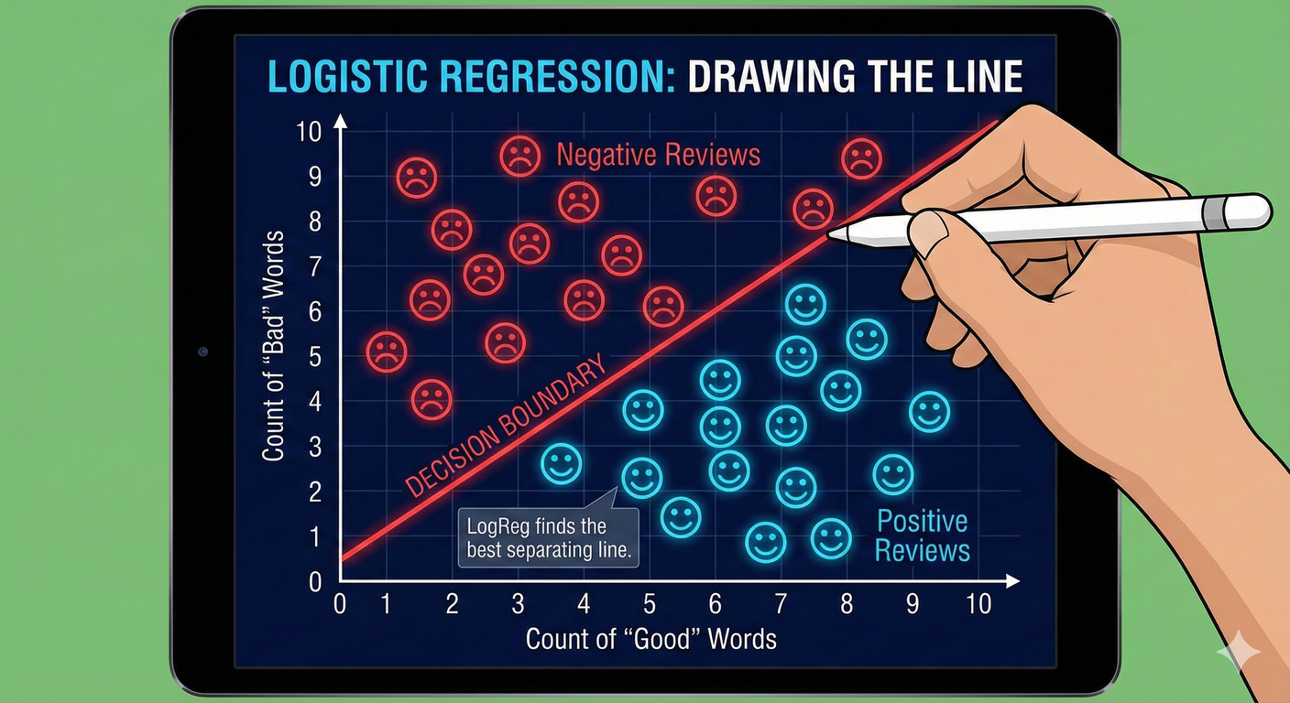
SRIB
PAGE 36
Logistic Regression: The Geometric Approach
Naive Bayes modeled the probability of words.
Logistic Regression models the decision boundary.
Imagine a 2D graph.
X-axis: Count of "Good".
Y-axis: Count of "Bad".
LogReg tries to draw a straight line that separates Positive reviews from Negative ones.

Slide 37

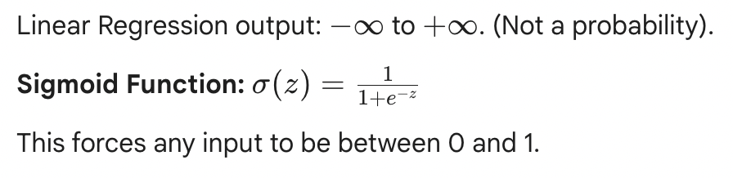
SRIB
PAGE 37
Squeezing the Output: The Sigmoid Function

Slide 38
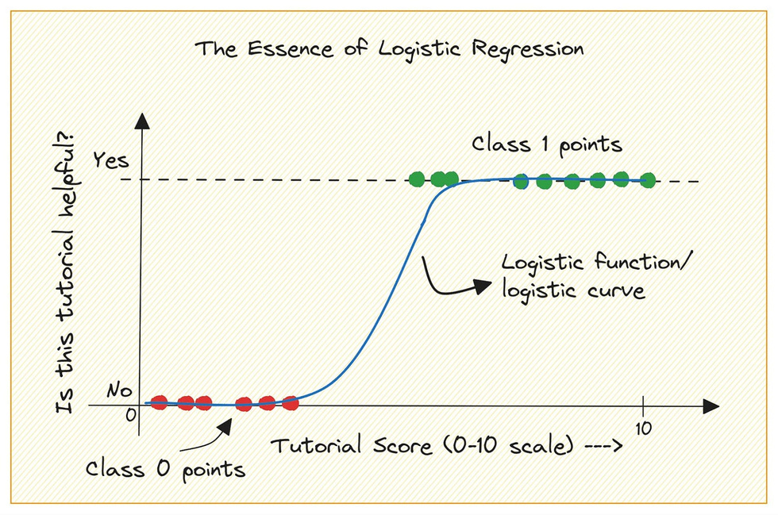
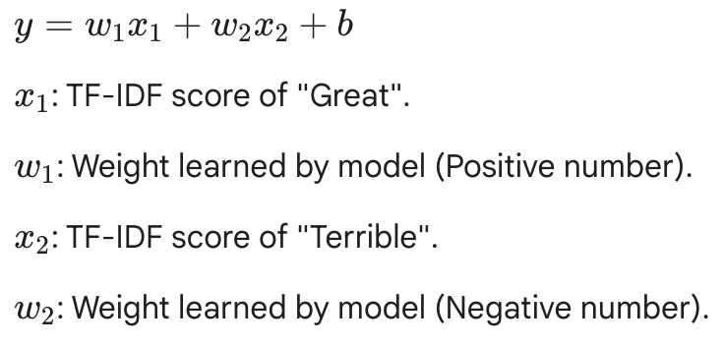
SRIB
PAGE 38
Logistic Regression Equation: The Math
Insight: We can look at the weights (w) to see which words drive sentiment!

Slide 39
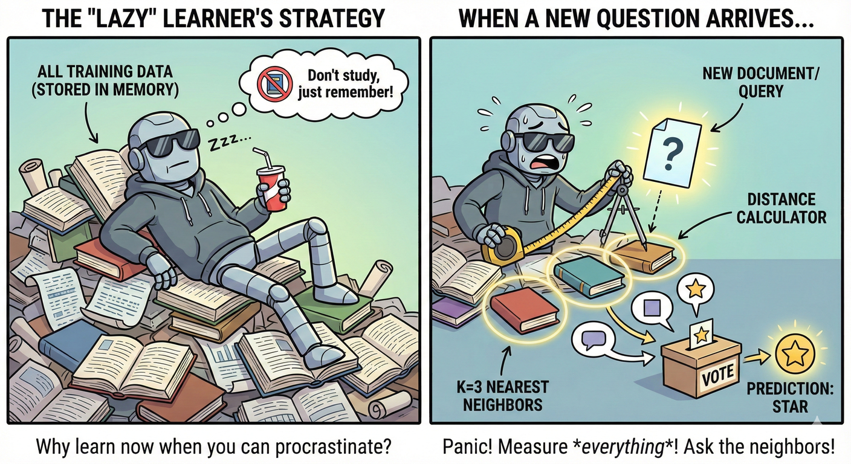
SRIB
PAGE 39
K-Nearest Neighbors : Understanding "Lazy Learning".
Concept: "If it looks like a duck and quacks like a duck..."
We don't learn weights. We store the entire training dataset in memory.
Process:
Receive new document.
Calculate Distance (Euclidean or Cosine) to every other document.
Pick the top K closest matches.
Vote.

Slide 40
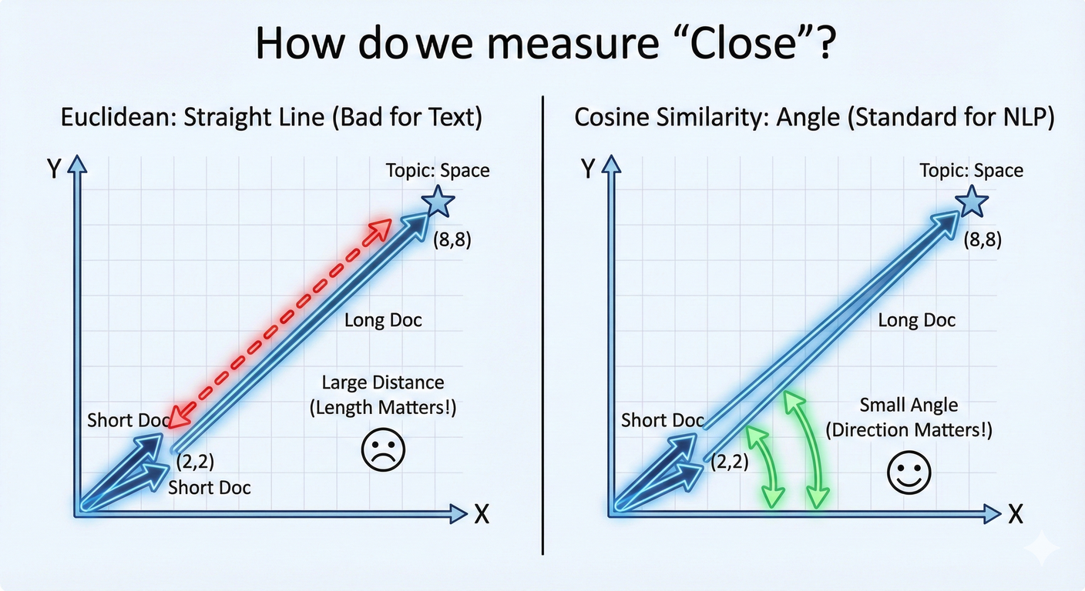
SRIB
PAGE 40
The Importance of Distance Metrics
How do we measure "Close"?
Euclidean: Straight line distance. (Bad for text, because long documents are "far" from short documents even if they have the same topic).
Cosine Similarity: Measures the angle between vectors. (Standard for NLP).
We will deep dive into Cosine Similarity tomorrow with Embeddings.

Slide 41
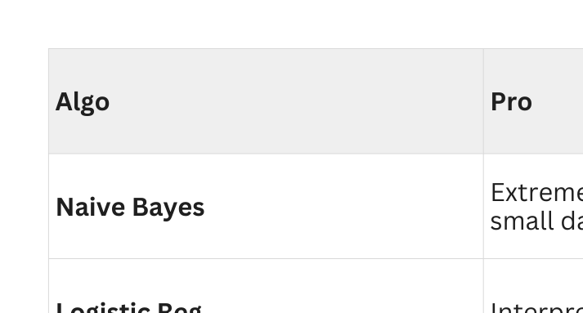
SRIB
PAGE 41
Pros & Cons of Classical Models

Slide 42
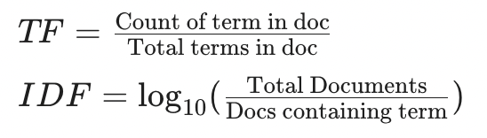
SRIB
PAGE 42
Quiz Question 1 - TF-IDF Numerical
Scenario: You have a small corpus of 3 documents.
Doc A: "Apple apple fruit"
Doc B: "Apple phone"
Doc C: "Banana fruit"
Task: Calculate the TF-IDF score for the word "Apple" in Doc A.
A) 0.66
B) 0.117
C) 0.0
D) 0.33

Slide 43
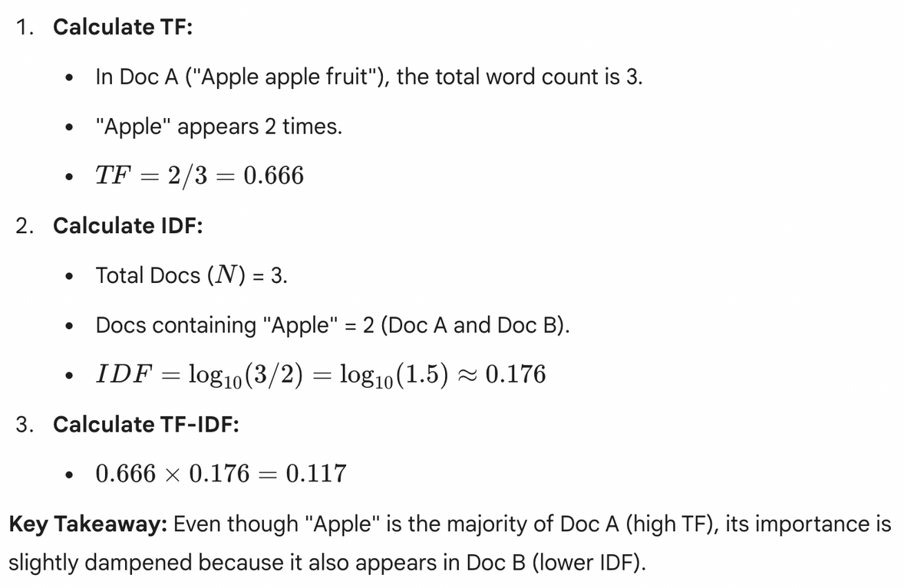

SRIB
PAGE 43
Answer: B (0.117)

Slide 44
SRIB
PAGE 44
Quiz Question 2 - N-Gram Theory (Fill in the Blank)
Statement: "As we increase N in an N-Gram model (e.g., moving from Bigrams to 5-grams), the model's ability to capture long-term context __________, but the risk of data sparsity (zero probabilities) __________."
A) Decreases; Increases
B) Increases; Decreases
C) Increases; Increases
D) Decreases; Decreases

Slide 45
SRIB
PAGE 45
Answer: C (Increases; Increases)
Context (First Blank): A 5-gram looks at the previous 4 words. A Bigram looks at only 1. Therefore, 5-grams capture much more context and nuance (Increase).
Sparsity (Second Blank): The sequence "The quick brown fox jumps" is far rarer than just "fox jumps". As you require longer exact matches, the chance of finding them in your training data drops to zero. This is the Curse of Dimensionality in NLP (Increase).

Slide 46
SRIB
PAGE 46
Quiz Question 3 - Naive Bayes Logic (True/False)
Scenario: You are training a Naive Bayes classifier to detect "Sports" articles.
Statement: "The model sees the phrase 'Manchester United'. The Naive Bayes algorithm explicitly learns that 'Manchester' and 'United' are a single compound entity that appear together."
Is this statement True or False?

Slide 47
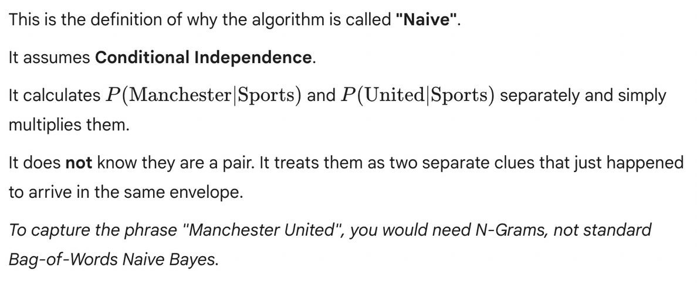
SRIB
PAGE 47
Answer: False

Slide 48
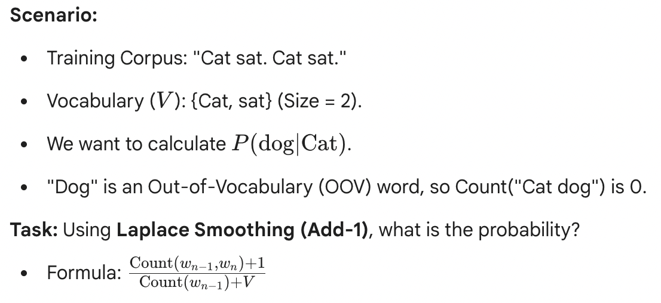
SRIB
PAGE 48
uiz Question 4 - Laplace Smoothing (Numerical)
A) 0
B) 1/4
C) 1/3
D) 0.5

Slide 49
SRIB
PAGE 49
Answer: B (1/4)
Numerator: Count("Cat dog") is 0. We add 1. Total = 1.
Denominator: Count("Cat") appears 2 times in the corpus. We add V (Vocabulary size is 2). Total = 2 + 2 = 4.
Result: 1 / 4 = 0.25.
Why this matters: The probability is no longer zero! The model now thinks "dog" is possible, just very unlikely.

Slide 50
SRIB
PAGE 50
Quiz Question 5 - Algorithm Selection (MSQ)
Scenario: You have a dataset of 5 million text documents (Very large) and you need to build a spam filter quickly. You care more about inference speed (how fast it runs) than getting that final 0.1% of accuracy.
Which algorithms are suitable? (Select two)
A) K-Nearest Neighbors (KNN)
B) Naive Bayes
C) Logistic Regression
D) Deep Learning (BERT)

Slide 51
SRIB
PAGE 51
Answer: B and C
B (Naive Bayes): Correct. It is extremely fast. It's just simple multiplication.
C (Logistic Regression): Correct. Once trained, it's just a dot product equation (y = mx+b). Very fast.
Why A is wrong (KNN): KNN is a "Lazy Learner". At prediction time, it has to measure the distance between the new email and all 5 million existing emails. It would be incredibly slow.
Why D is wrong (BERT): Overkill for this specific requirement. Deep Learning is computationally heavy and slower for simple tasks like spam filtering compared to classical methods.

Slide 52
SRIB
PAGE 52
Quiz Question 6 - Vector Dimensions (Conceptual)
Scenario: You have a corpus with 20,000 unique words. You decide to use One-Hot Encoding to represent the sentence: "I love AI".
Question: What will be the dimensions (shape) of the vector for just the word "love", and how many zeros will it contain?
A) Shape (1, 3); 0 zeros.
B) Shape (1, 20,000); 2 zeros.
C) Shape (1, 20,000); 19,999 zeros.
D) Shape (1, 3); 2 zeros.

Slide 53
SRIB
PAGE 53
Answer: C [Shape (1, 20,000); 19,999 zeros]
Dimension Rule: In One-Hot Encoding, the vector length is always equal to the Vocabulary size (V). Here, V = 20,000.
Sparsity: The vector has a single 1 at the index for "love", and 0 everywhere else.
Calculation: 20,000 - 1 = 19,999 zeros.
Why this matters: This highlights the Sparsity problem. You are storing 19,999 useless numbers just to represent one word. This motivates why we need Embeddings (Day 3).

Slide 54
SRIB
PAGE 54
Quiz Question 7 - Evaluation Metrics (Scenario)
Scenario: You are building an NLP model to detect Cancer from doctor's notes.
Positive Class: Cancer Detected.
Negative Class: Healthy.
Constraint: It is acceptable to accidentally flag a healthy person as sick (they just get a checkup), but it is unacceptable to miss a sick person (they might die).
Question: Which metric should you optimize for?
A) Precision
B) Recall
C) Accuracy
D) Specificity

Slide 55
SRIB
PAGE 55
Answer: B (Recall)
Recall Formula: TP / (TP + FN)
Interpretation: "Of all the people who actually have cancer, how many did we find?"
Why B? We want to minimize False Negatives (missing a sick person). High Recall ensures we catch almost every case.
Why not A (Precision)? Precision cares about "Of the ones we flagged, how many were actually sick?" It tries to minimize False Alarms. In medicine, we tolerate false alarms to save lives.

Slide 56
SRIB
PAGE 56
Quiz Question 8 - Bag of Words Limitation (Logic)
Scenario: Consider two sentences:
"The dog bit the man."
"The man bit the dog."
Question: If you represent these sentences using a standard Bag of Words (BoW) model, how will their vectors compare?
A) The vectors will be orthogonal (perpendicular).
B) The vectors will be identical.
C) The vector for Sentence 2 will be larger.
D) The vectors will be negatives of each other.

Slide 57
SRIB
PAGE 57
Answer: B (Identical)
The "Bag" Concept: BoW looks only at word counts. It ignores order.
Counts:
Sentence 1: {The: 2, dog: 1, bit: 1, man: 1}
Sentence 2: {The: 2, dog: 1, bit: 1, man: 1}
Result: Since the counts are exactly the same, the vectors are identical ([2, 1, 1, 1]).
Takeaway: This proves why BoW fails at understanding syntax and roles (Who did what to whom?).

Slide 58
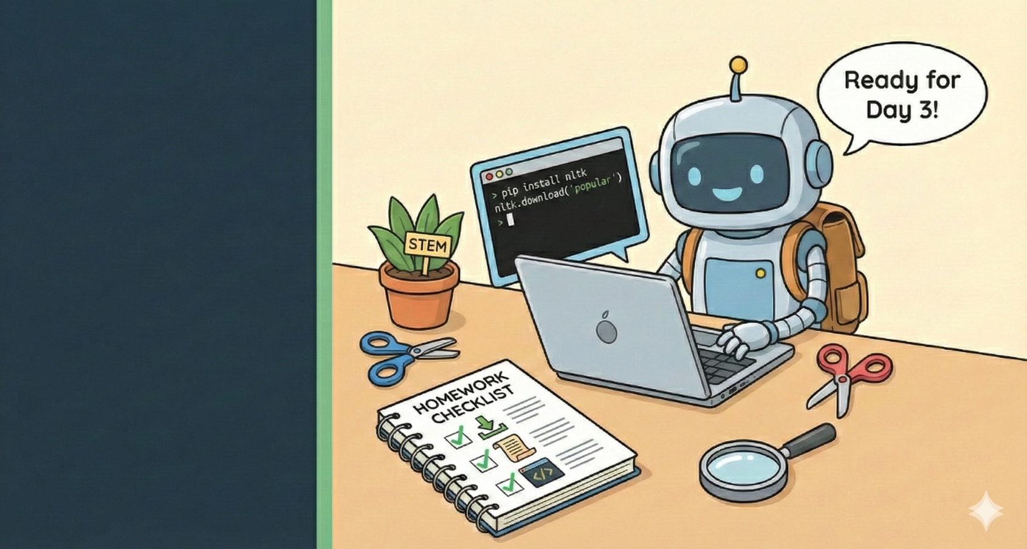
SRIB
PAGE 58
Summary of Day 2 & Beyond
Summary :
Text --> Numbers (One-Hot, BoW, TF-IDF)
Context --> N-Grams, Co-occurrence.
Prediction --> Naive Bayes, Logistic Regression
The Cliffhanger: The Problem We Haven't Solved
Our models still don't understand meaning.
They don't know that "King" is related to "Prince".
They don't know that "Walk" and "Stroll" are synonyms.
Tomorrow: We enter the era of Deep Learning and Word Embeddings.

Slide 59
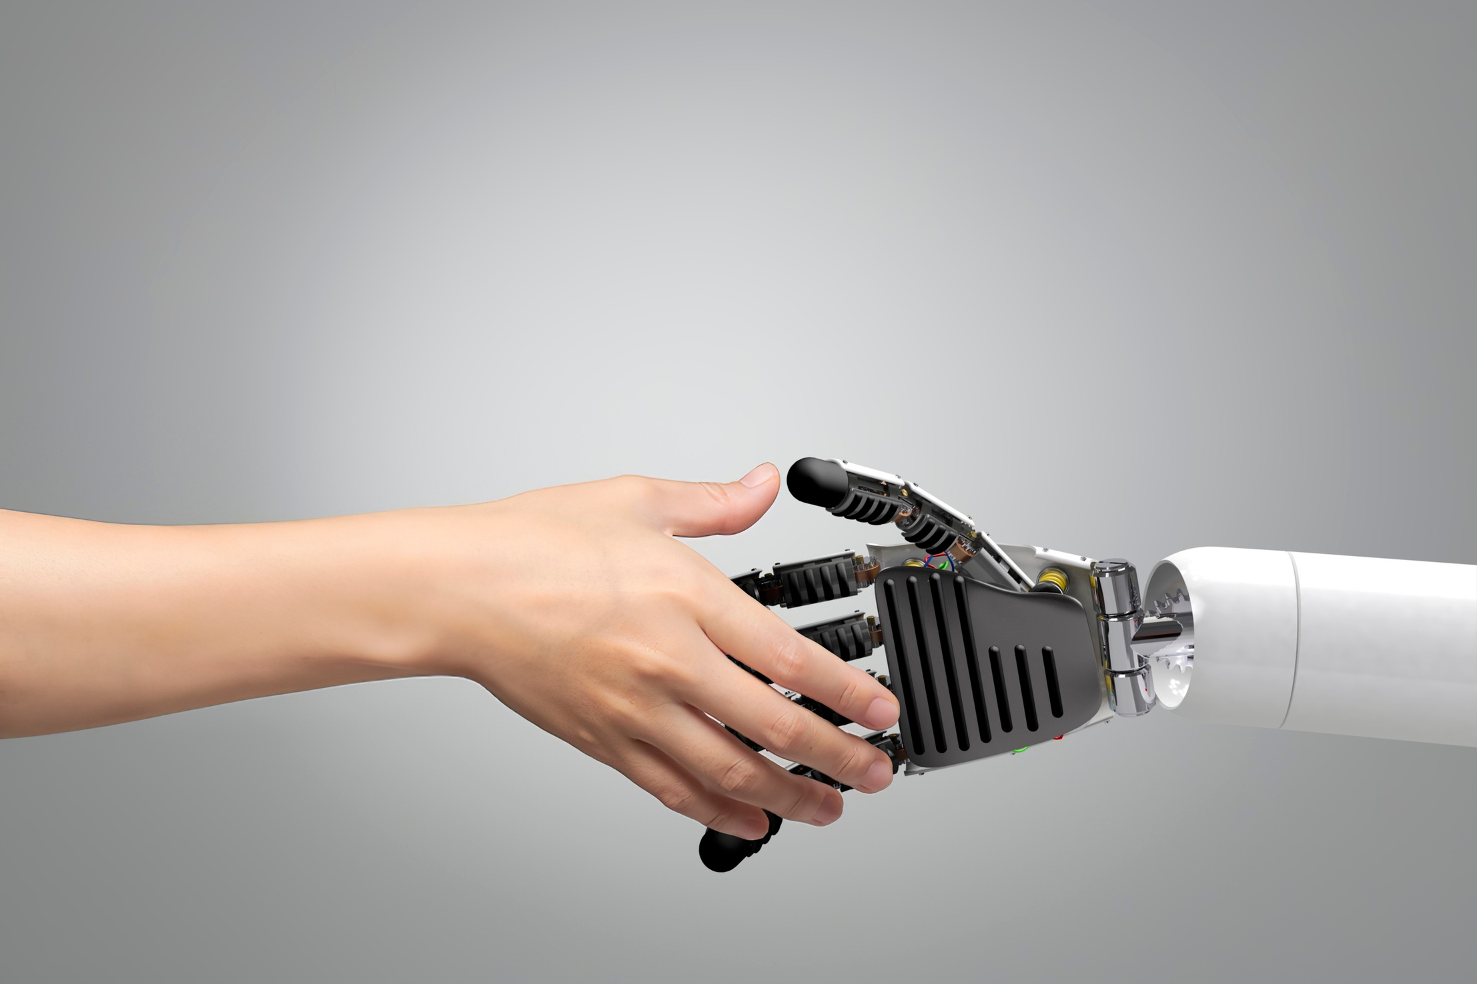
SRIB
PAGE 59
THANK YOU
Q&A

